Slide 1
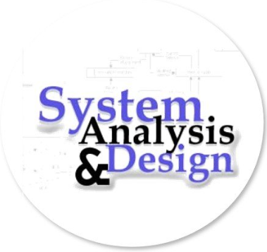
SYSTEM ANALYSIS & DESIGN
LECTURER: SUMAN THAPALIYA

Slide 2
UNIT 3: DATA & PROCESS MODELLING
Introduction
Overview of Data & Process Modeling Tools
Data Dictionary (Introduction to CASE)
Using CASE Tools for Documentation
Documenting the data elements
Documenting the data stores
Documenting the processes
ERD
Data dictionary reports

Slide 3
Process Modelling
• Graphically represent the processes that capture, manipulate, store and distribute data between a system and its environment and among system components
• Data flow diagrams (DFD) o Graphically illustrate movement of data between external entities and the processes and data stores within a system • Modeling a system’s process o Utilize information gathered during requirements determination o Structure of the data is also modeled in addition to the processes
• Deliverables and Outcomes o Set of coherent, interrelated data flow diagrams
o Context data flow diagram (DFD)
• Scope of system o DFDs of current system
• Enables analysts to understand current system o DFDs of new logical system
• Technology independent
• Show data flows, structure and functional requirements of new system
o Project dictionary and CASE repository

Slide 4
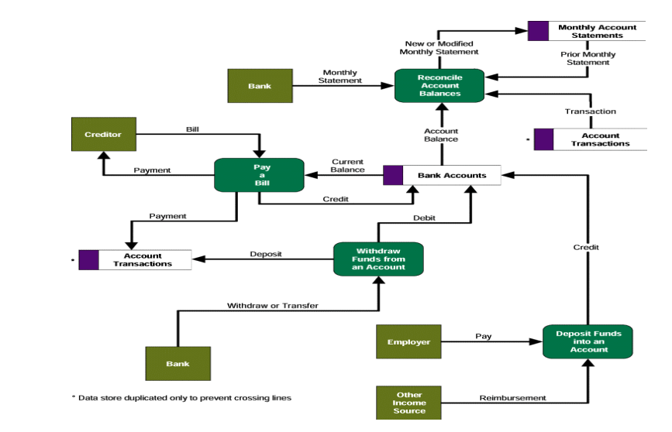
Simple Data Flow Diagram

Slide 5
DFD Elements
Data Flows & Control Flows
• A data flow represents an input of data to a process, or the output of data from a process.
o A data flow may also be used to represent the creation, reading, deletion, or updating of data in a file or database (data store).
o A composite data flow is a data flow that consists of other data flows.
• A control flow represents a condition or nondata event that triggers a process. o Used sparingly on DFDs.

Slide 6

Data Stores
A data store is an inventory of data.
o Frequently implemented as a file or database.
o A data store is “data at rest” compared to a data flow that is “data in motion.”
o Almost always one of the following:
• Persons (or groups of persons)
• Places
• Objects
• Events (about which data is captured)
• Concepts (about which data is important) o Data stores depicted on a DFD store all instances of data entities (depicted on an ERD)

Slide 7
External Agents
• An external agent defines a person, organization unit, or other organization that lies outside of the scope of the project but that interacts with the system being studied.
o External agents define the “boundary” or scope of a system being modeled.
o As scope changes, external agents can become processes, and vice versa.
Almost always one of the following:
Office, department, division inside the business but outside the system scope.
An external organization or agency.
Another business or another information system.
One of your system’s end-users or managers.

Slide 8
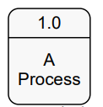
Process Concepts
A process is work performed on, or in response to, incoming data flows or conditions so that they are transformed, stored or distributed.
A System is a Process

Slide 9
Process Decomposition
Functional Decomposition
o The act of breaking a system into its component subsystems, processes, and sub processes. Each level of abstraction reveals more or less detail.
Decomposition Diagrams
o A decomposition diagram or hierarchy chart shows the top-down, functional decomposition of a system
o Numbering Scheme
Decomposition of DFDs
o Functional decomposition
o Act of going from one single system to many component processes
o Repetitive procedure
o Lowest level is called a primitive DFD
o Level-N Diagrams o A DFD that is the result of n nested decompositions of a series of sub processes from a process on a level-0 diagram

Slide 10
Contact Diagram
A data flow diagram (DFD) of the scope of an organizational system that shows the system boundaries, external entities that interact with the system and the major information flows between the entities and the system.
Shows the context into which the business process fits.
Shows the overall business process as just one process.
Shows all the outside entities that receive information from or contribute information to the system

Slide 11
CASE
CASE stands for Computer Aided Software Engineering. It means, development and maintenance of software projects with help of various automated software tools.
Computer-aided software engineering (CASE) is the domain of software tools used to design and implement applications.
CASE tools are similar to and were partly inspired by computer-aided design (CAD) tools used for designing hardware products.
CASE tools are used for developing high-quality, defect-free, and maintainable software

Slide 12
CASE Tools
CASE tools are set of software application programs, which are used to automate SDLC activities. CASE tools are used by software project managers, analysts and engineers to develop software system.
There are number of CASE tools available to simplify various stages of Software Development Life Cycle such as Analysis tools, Design tools, Project management tools, Database Management tools, Documentation tools are to name a few.
Use of CASE tools accelerates the development of project to produce desired result and helps to uncover flaws before moving ahead with next stage in software development.

Slide 13
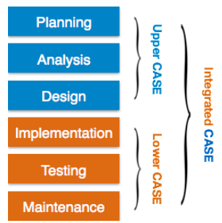
COMPONENTS OF CASE Tools
CASE tools can be broadly divided into the following parts based on their use at a particular SDLC stage:
Central Repository - CASE tools require a central repository, which can serve as a source of common, integrated and consistent information. Central repository is a central place of storage where product specifications, requirement documents, related reports and diagrams, other useful information regarding management is stored. Central repository also serves as data dictionary.

Slide 14
Upper Case Tools - Upper CASE tools are used in planning, analysis and design stages of SDLC.
Lower Case Tools - Lower CASE tools are used in implementation, testing and maintenance.
Integrated Case Tools - Integrated CASE tools are helpful in all the stages of SDLC, from Requirement gathering to Testing and documentation.
CASE tools can be grouped together if they have similar functionality, process activities and capability of getting integrated with other tools.

Slide 15
Scope of Case Tools
The scope of CASE tools goes throughout the SDLC.
Case Tools Types
Now we briefly go through various CASE tools
Diagram tools
These tools are used to represent system components, data and control flow among various software components and system structure in a graphical form. For example, Flow Chart Maker tool for creating state-of-the-art flowcharts.
Process Modeling Tools
Process modeling is method to create software process model, which is used to develop the software. Process modeling tools help the managers to choose a process model or modify it as per the requirement of software product. For example, EPF Composer.

Slide 16
Project Management Tools
These tools are used for project planning, cost and effort estimation, project scheduling and resource planning. Managers have to strictly comply project execution with every mentioned step in software project management. Project management tools help in storing and sharing project information in real-time throughout the organization. For example, Creative Pro Office, Trac Project, Basecamp.
Documentation Tools
Documentation in a software project starts prior to the software process, goes throughout all phases of SDLC and after the completion of the project.
Documentation tools generate documents for technical users and end users. Technical users are mostly in-house professionals of the development team who refer to system manual, reference manual, training manual, installation manuals etc. The end user documents describe the functioning and how-to of the system such as user manual. For example, Doxygen, DrExplain, Adobe RoboHelp for documentation.

Slide 17
Analysis Tools
These tools help to gather requirements, automatically check for any inconsistency, inaccuracy in the diagrams, data redundancies or erroneous omissions. For example, Accept 360, Accompa, CaseComplete for requirement analysis, Visible Analyst for total analysis.
Design Tools
These tools help software designers to design the block structure of the software, which may further be broken down in smaller modules using refinement techniques. These tools provides detailing of each module and interconnections among modules. For example, Animated Software Design

Slide 18
Configuration Management Tools
An instance of software is released under one version. Configuration Management tools deal with –
a.Version and revision management
b. Baseline configuration management
c. Change control management
CASE tools help in this by automatic tracking, version management and release management. For example, Fossil, Git, Accu REV.
Change Control Tools
These tools are considered as a part of configuration management tools. They deal with changes made to the software after its baseline is fixed or when the software is first released. CASE tools automate change tracking, file management, code management and more. It also helps in enforcing change policy of the organization.
Programming Tools
These tools consist of programming environments like IDE (Integrated Development Environment), in-built modules library and simulation tools. These tools provide comprehensive aid in building software product and include features for simulation and testing. For example, Cscope to search code in C, Eclipse.

Slide 19
Prototyping Tools
Software prototype is simulated version of the intended software product. Prototype provides initial look and feel of the product and simulates few aspect of actual product.
Prototyping CASE tools essentially come with graphical libraries. They can create hardware independent user interfaces and design. These tools help us to build rapid prototypes based on existing information. In addition, they provide simulation of software prototype. For example, Serena prototype composer, Mockup Builder.
Web Development Tools
These tools assist in designing web pages with all allied elements like forms, text, script, graphic and so on. Web tools also provide live preview of what is being developed and how will it look after completion. For example, Fontello, Adobe Edge Inspect, Foundation 3, Brackets.

Slide 20
Quality Assurance Tools
Quality assurance in a software organization is monitoring the engineering process and methods adopted to develop the software product in order to ensure conformance of quality as per organization standards. QA tools consist of configuration and change control tools and software testing tools. For example, SoapTest, AppsWatch, JMeter.
Maintenance Tools
Software maintenance includes modifications in the software product after it is delivered. Automatic logging and error reporting techniques, automatic error ticket generation and root cause Analysis are few CASE tools, which help software organization in maintenance phase of SDLC. For example, Bugzilla for defect tracking, HP Quality Center.

Slide 21
ERD Covered in Previous Chapter
END OF CHAPTER 3
☺

